Slide 1




New York City ----Parking Meters
Agnor,Renee
Yang,Guang
Weissmann,John

Slide 2
Research Topic/Purpose
Have you experiencing parking issues in NYC? Will it be helpful if you have full access to meter parking information?
1
2
Which area/streets are more accessible for street parking?
Which time frame you may tentatively avoid paying for parking?
Where are the closest 10 parking meter in chosen well known locations in NYC?
Create a tool for New York city residents and tourist to utilize to locate neighborhoods with the most access to easy public parking through parking meters. Also, allow tourists to find nearby street parking.

Slide 3
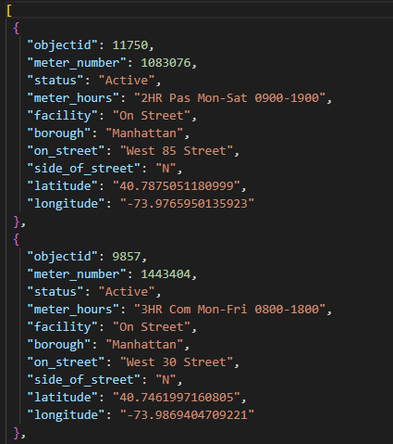
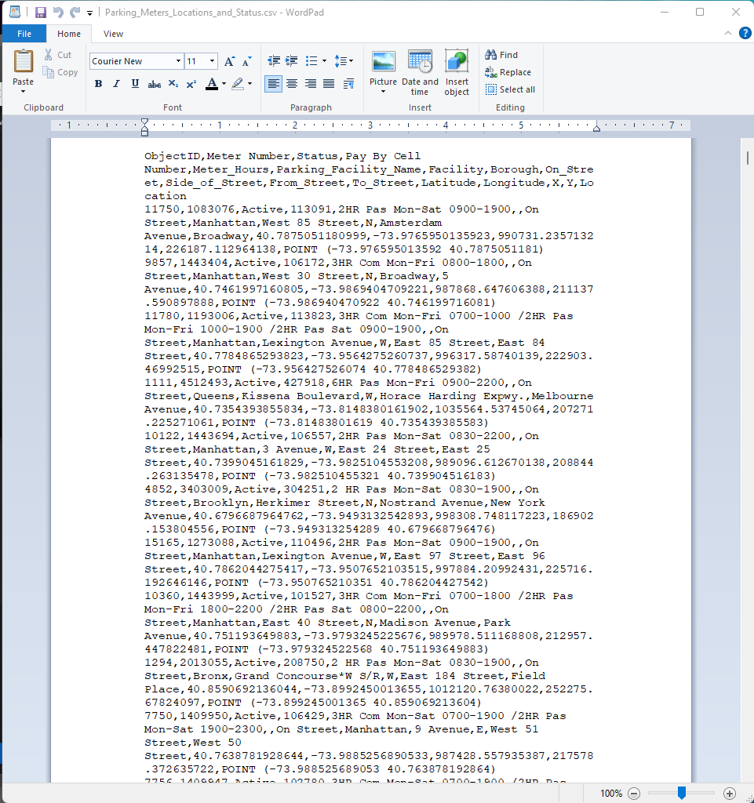
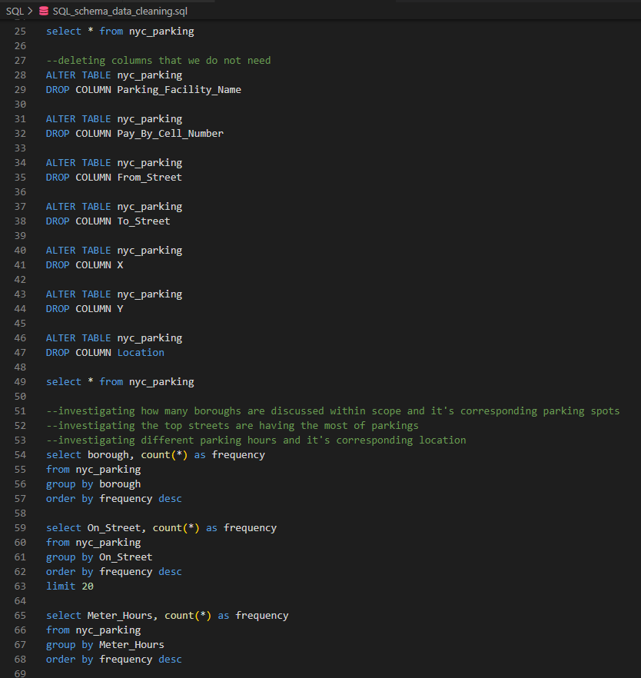
Data/Sources
Kaggle – New York Parking Meters Dataset https://www.kaggle.com/datasets/nathaniellybrand/new-york-parking-meters- dataset?resource=download
Data cleaning--SQL
Notes:
When conducting research, it is easy to go to one source: Wikipedia. However, you need to include a variety of sources in your research. Consider the following sources:
Who can I interview to get more information on the topic?
Is the topic current and will it be relevant to my audience?
What articles, blogs, and magazines may have something related to my topic?
Is there a YouTube video on the topic? If so, what is it about?
What images can I find related to the topic?

Slide 4
Flask API
Notes:
When conducting research, it is easy to go to one source: Wikipedia. However, you need to include a variety of sources in your research. Consider the following sources:
Who can I interview to get more information on the topic?
Is the topic current and will it be relevant to my audience?
What articles, blogs, and magazines may have something related to my topic?
Is there a YouTube video on the topic? If so, what is it about?
What images can I find related to the topic?

Slide 5
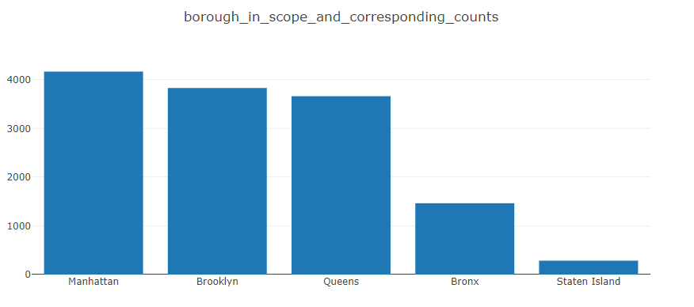
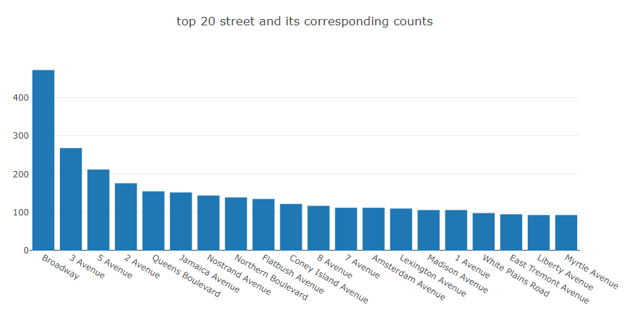
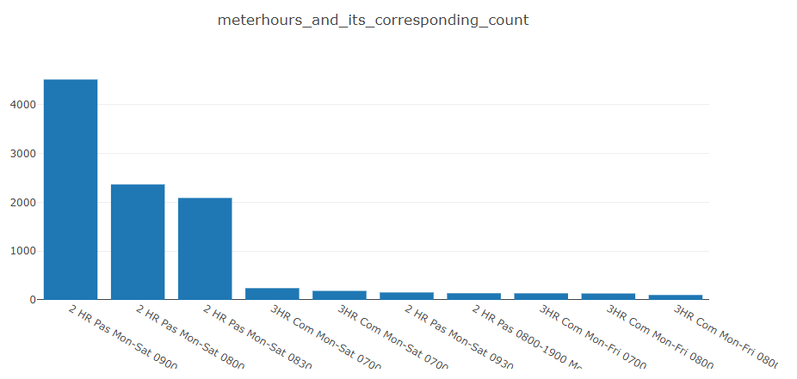
Charts/Plotly
Summarize and charted key information
Show detailed number when swipe the mouse
Notes:
When conducting research, it is easy to go to one source: Wikipedia. However, you need to include a variety of sources in your research. Consider the following sources:
Who can I interview to get more information on the topic?
Is the topic current and will it be relevant to my audience?
What articles, blogs, and magazines may have something related to my topic?
Is there a YouTube video on the topic? If so, what is it about?
What images can I find related to the topic?

Slide 6
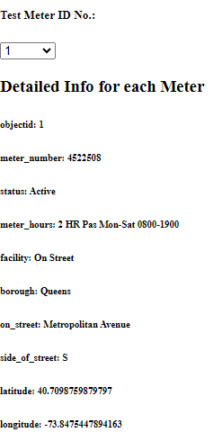
Charts/Plotly
Listed all meter information
Selected based of Meter ID
Dropdown menu set up numerically
Init screen when refreshing the page
Notes:
When conducting research, it is easy to go to one source: Wikipedia. However, you need to include a variety of sources in your research. Consider the following sources:
Who can I interview to get more information on the topic?
Is the topic current and will it be relevant to my audience?
What articles, blogs, and magazines may have something related to my topic?
Is there a YouTube video on the topic? If so, what is it about?
What images can I find related to the topic?

Slide 7
Mapping
Notes:
When conducting research, it is easy to go to one source: Wikipedia. However, you need to include a variety of sources in your research. Consider the following sources:
Who can I interview to get more information on the topic?
Is the topic current and will it be relevant to my audience?
What articles, blogs, and magazines may have something related to my topic?
Is there a YouTube video on the topic? If so, what is it about?
What images can I find related to the topic?

Slide 8
Mapping
Notes:
When conducting research, it is easy to go to one source: Wikipedia. However, you need to include a variety of sources in your research. Consider the following sources:
Who can I interview to get more information on the topic?
Is the topic current and will it be relevant to my audience?
What articles, blogs, and magazines may have something related to my topic?
Is there a YouTube video on the topic? If so, what is it about?
What images can I find related to the topic?

Slide 9
Thank you!
Any Questions?

